Slide 1
BCBM HTMA438: Subtype Analysis
GeoMx Digital Spatial Profiling

Slide 2
Overall Subtype Primary
HER2-/HR+: 13 pts
HER2-0: 2 pts
HER2-Low Positive: 6 pts
HER2 Unknown: 9 pts
HER2+/HR-: 2 pts
HER2+/HR+: 14 pts
TNBC: 9 pts
HER2-0: 5 pts
HER2-Low Positive: 2 pts
HER2 Unknown: 2 pts

Slide 3
Overall Subtype Mets (with Primary Fallback)
HER2-/HR+: 15 pts
HER2-0: 1 pt
HER2-Low Positive: 5 pts
HER2 Unknown/Not done: 9 pts
HER2+/HR-: 3 pts
HER2+/HR+: 12 pts
TNBC: 8 pts
HER2-0: 5 pts
HER2-Low Positive: 2 pts
HER2 Unknown: 1 pt

Slide 4
Changes in Primary to Mets Subtype
HER2+/HR+ → HER2-/HR+
3 pts
HER2-/HR+ → HER2+/HR+
1 pt
TNBC → HER2+/HR-
1 pt

Slide 5
Changes in HER2 Status
HER2+ → HER2-low positive
1 pt
HER2+ → HER2-0
1 pt
HER2+ → Unknown/Not done
5 pts

Slide 6
Changes in HER2 Status
HER2-0 → HER2-low positive
2 pts
HER2-0 → Unknown/Not done
2 pts

Slide 7
Changes in HER2 Status
HER2-Low Positive → HER2+
2 pts
HER2-Low Positive → HER2-0
1 pt
HER2-Low Positive → Unknown/Not done
5 pts

Slide 8
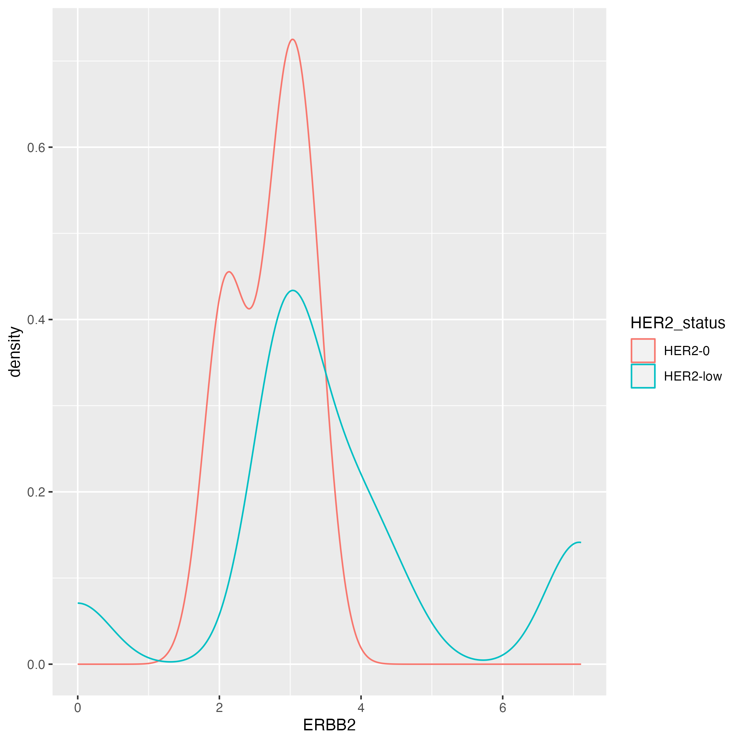
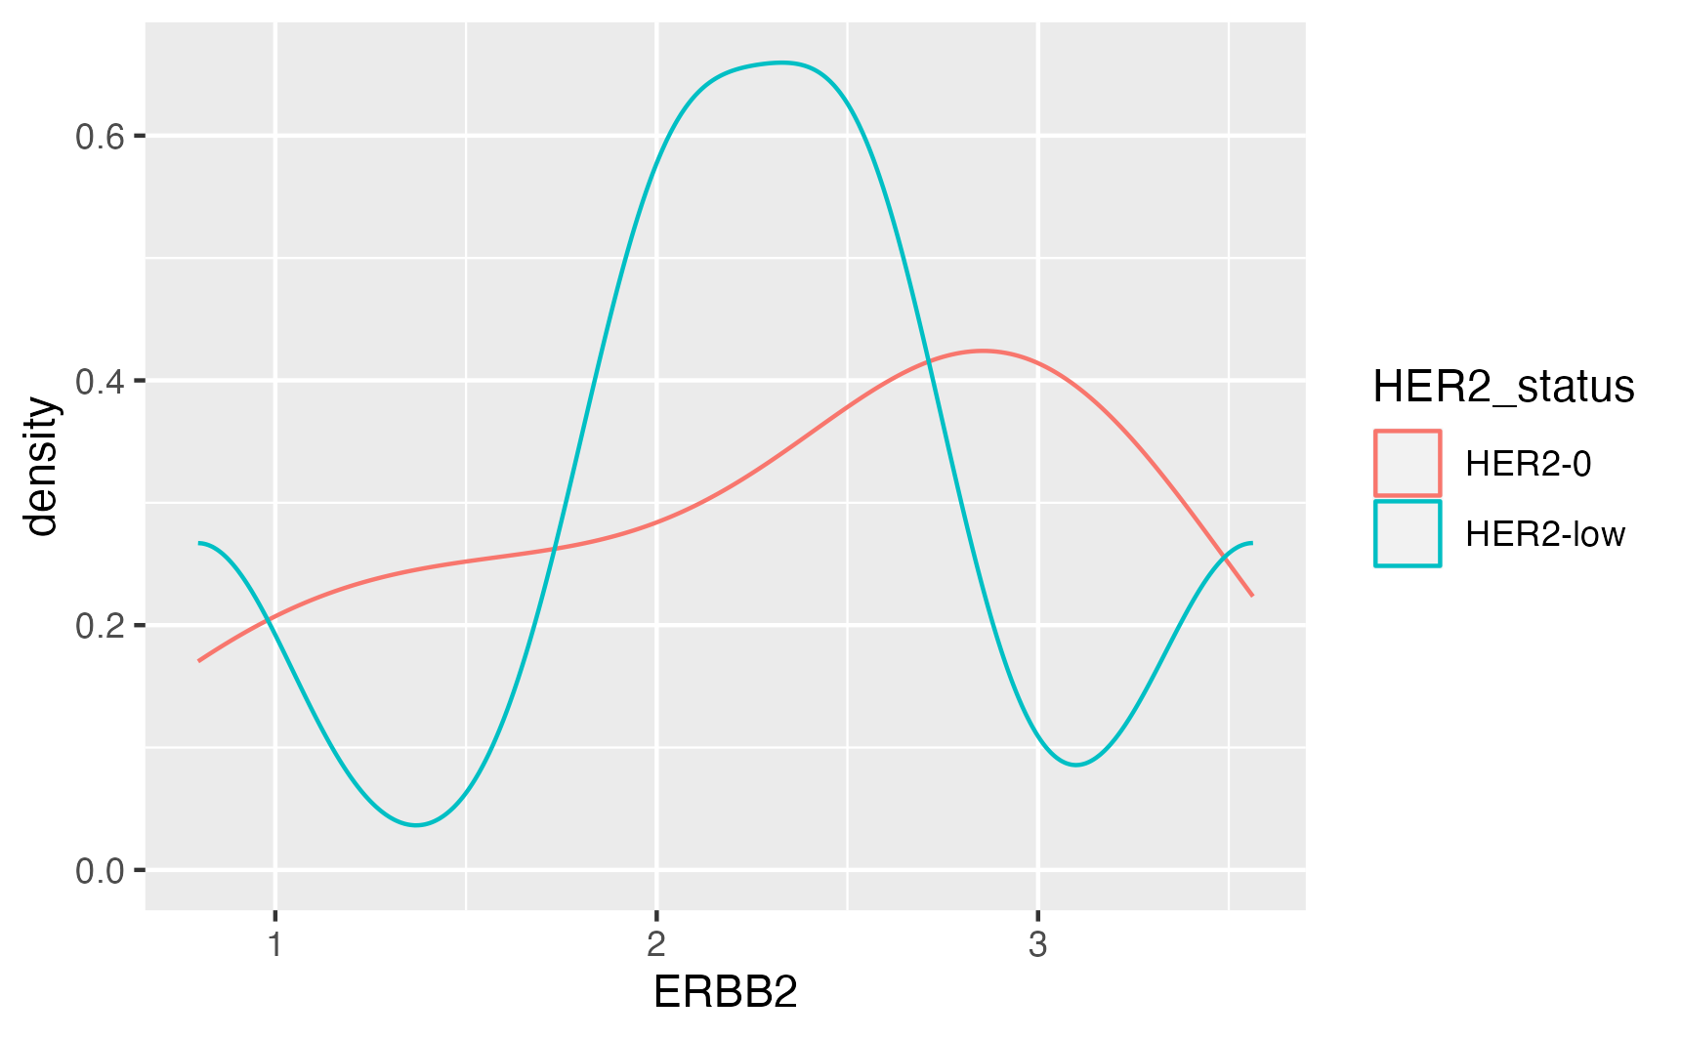
HER2 Primary Status in TNBC and HR+ immune AOI
TNBC
HER2-/HR+

Slide 9
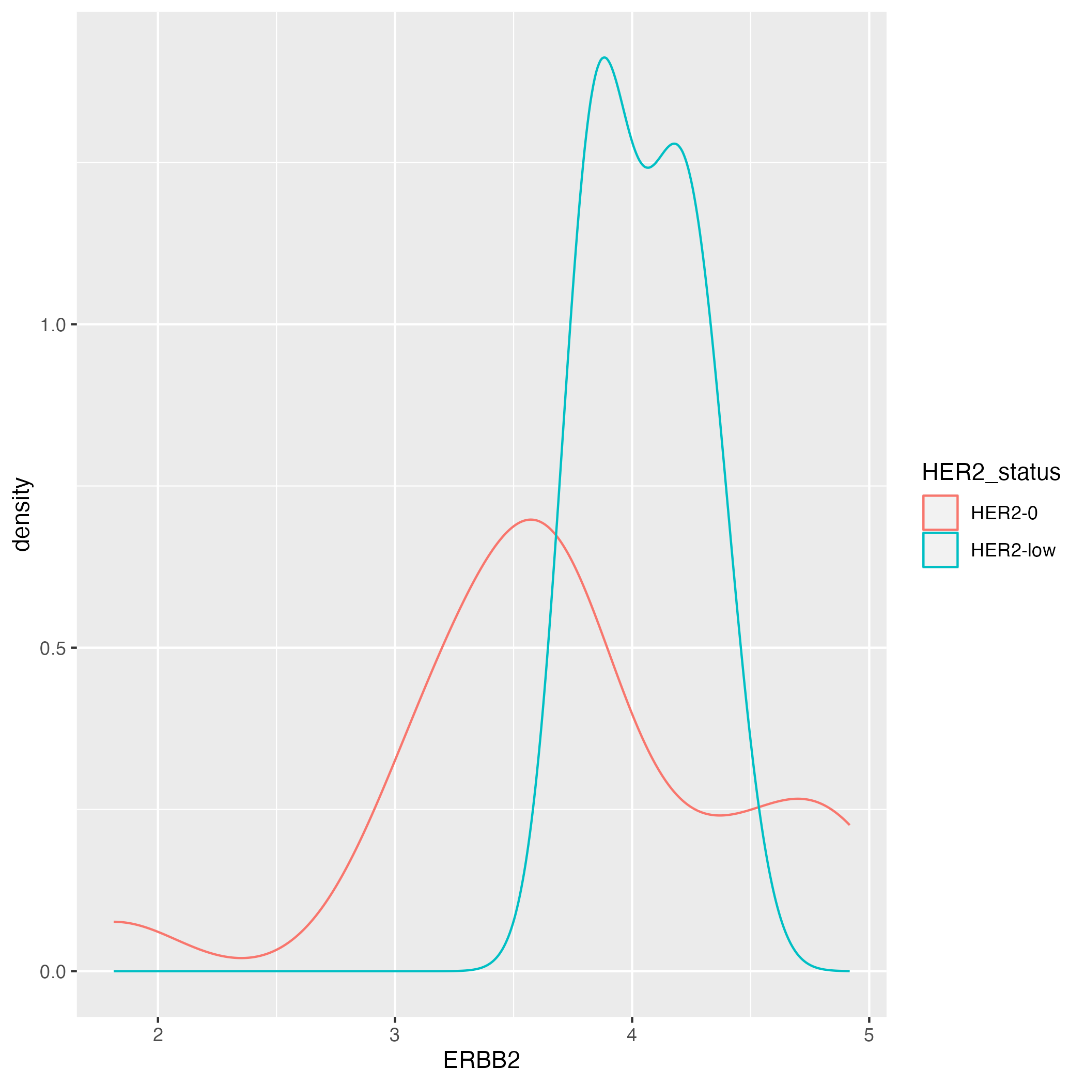
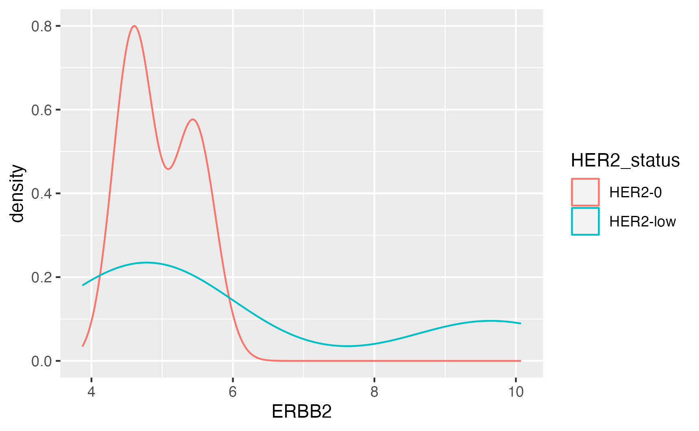
HER2 Primary Status in TNBC and HR+ tumor AOI
TNBC
HER2-/HR+

